Slide 1


Customer Feedback Analysis and Improvement
Done by: hana Mohsen wesal ahmed
malak ahmed Mohamed Yasser

Slide 2
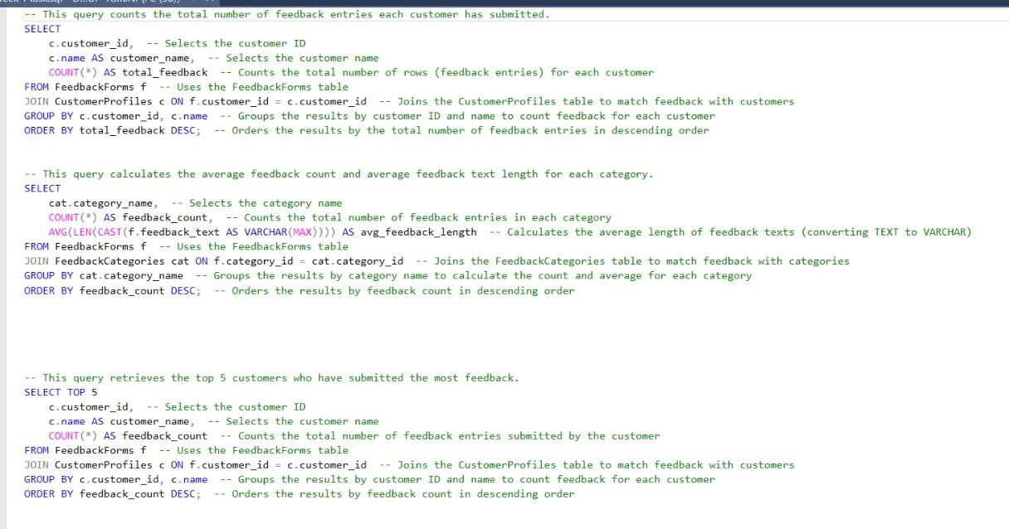

Slide 3
Counting Customer Feedback Entries
Customer Feedback Count: The first query counts how many feedback entries each customer has submitted. It joins customer data with feedback forms and orders the results by the highest feedback count.
Average Feedback by Category: The second query calculates the number of feedback entries and the average length of feedback text for each category. It groups by category name and orders by the highest feedback count.
Top 5 Customers by Feedback: The third query retrieves the top 5 customers who submitted the most feedback, ordered by feedback count in descending order.
Each query uses joins, grouping, and ordering to analyze feedback data efficiently.

Slide 4
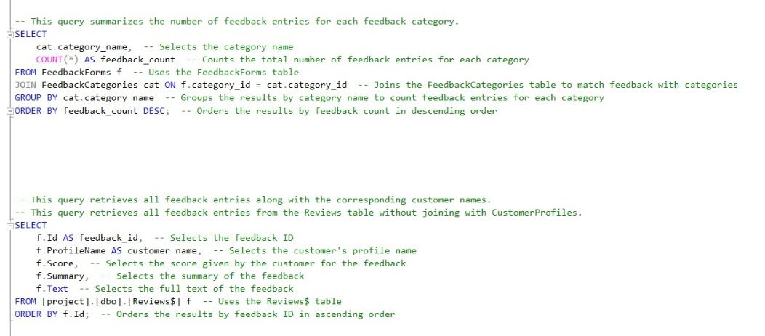

Slide 5
Query 1:
Counts feedback entries per category by joining the FeedbackForms and FeedbackCategories tables, groups them by category name, and orders by feedback count in descending order.
Query 2:
Retrieves detailed feedback entries from the Reviews$ table, including customer names, scores, summaries, and full feedback text, ordered by feedback ID in ascending order.

Slide 6
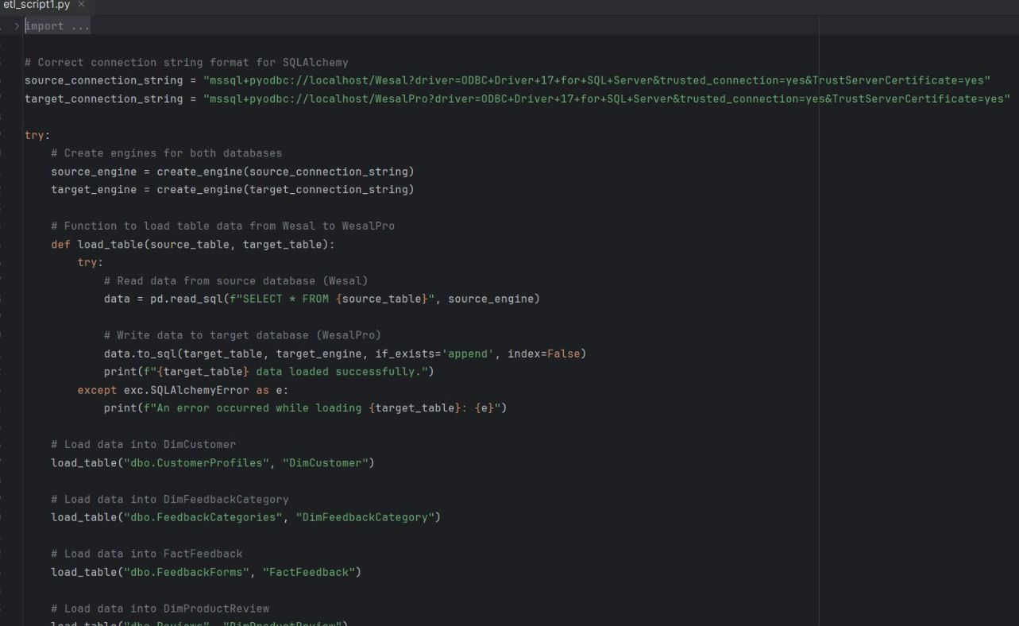

Slide 7
This Python script is designed to transfer data between two SQL Server databases using SQLAlchemy and PyODBC. It establishes connections to both databases, reads data from specific source tables, and writes it to corresponding target tables. The process is automated through a function that handles each table’s data transfer, with error handling in place to capture and report any issues during the loading process. The script loads data into tables like DimCustomer, DimFeedbackCategory, FactFeedback, and DimProductReview.

Slide 8
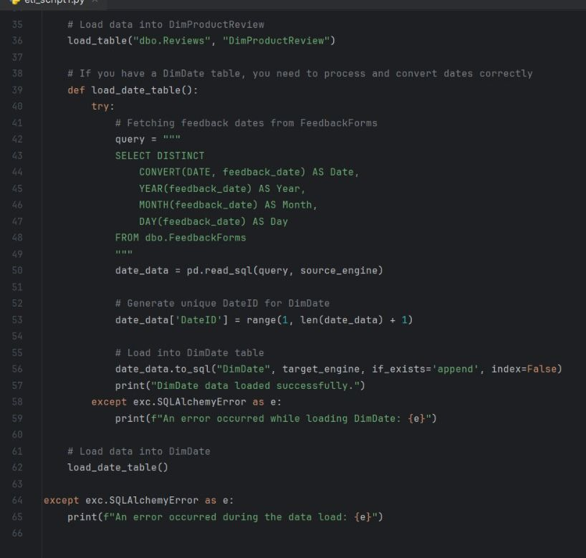

Slide 9
This code snippet is part of an ETL (Extract, Transform, Load) process designed to load data into a DimDate table. It starts by loading data from the FeedbackForms table, selecting and converting the feedback date into components like Year, Month, and Day. The processed date data is then assigned a unique DateID. Finally, the data is loaded into the DimDate table in a target database using SQLAlchemy. Error handling is built in to catch and report any issues that occur during the process.This script is essential for converting raw feedback date information into a structured format for easier analysis and reporting.

Slide 10
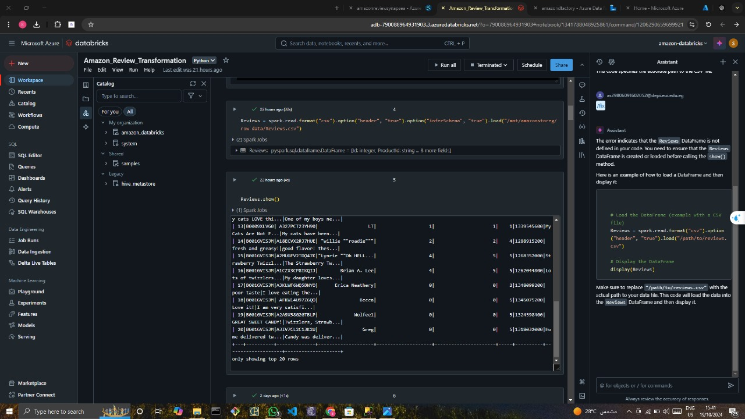

Slide 11
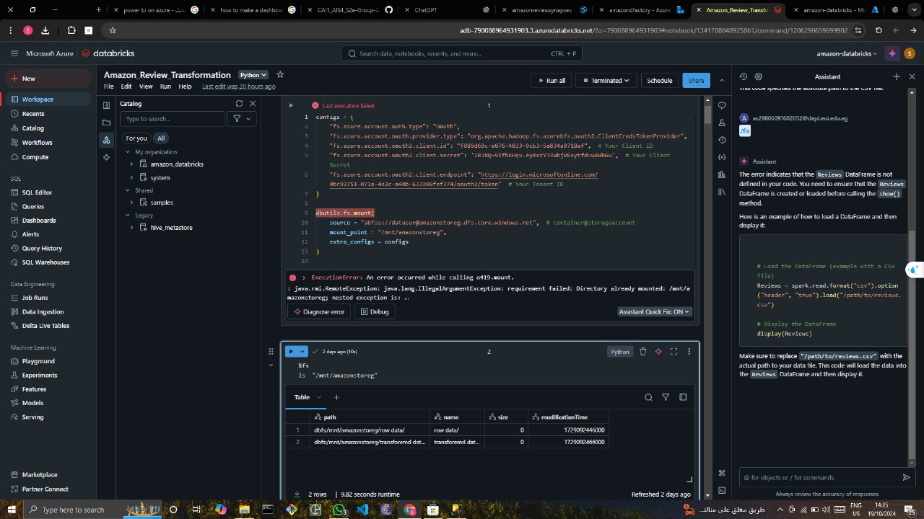

Slide 12
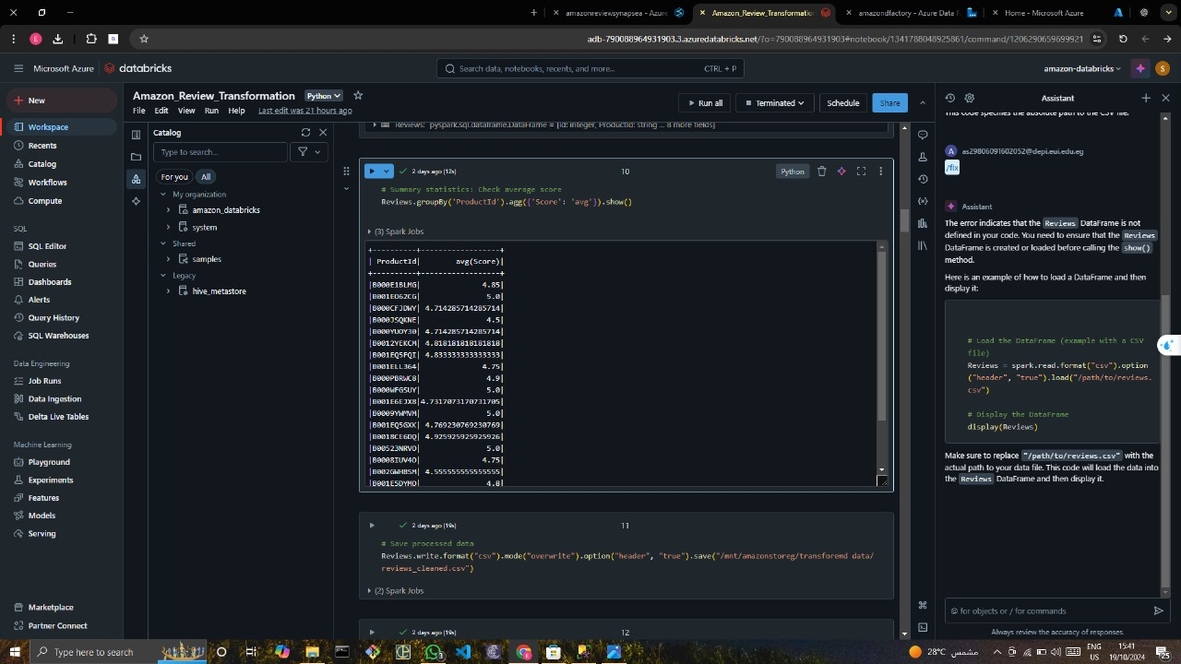

Slide 13
Setting up the environment on Azure:
Began by creating a Resource Group in Azure, which serves as a container for all the related resources in my project.Inside this resource group, I created an Azure Storage Account and organized it with two directories:
Raw Data: This directory stores the original, unprocessed data.
Transformed Data: This directory is for the processed and cleaned data.I then uploaded the dataset to the Raw Data directory, preparing it for further processing.

Slide 14
Data Integration using Azure Data Factory:
Next, I moved on to Azure Data Factory where I created a pipeline to automate the data flow.
The pipeline was designed to move data from the Raw Data directory (source) to the Transformed Data directory (sink) after transformation. This step ensured a smooth transition from raw to cleaned data, making it ready for analysis.

Slide 15
Writing SQL Queries in Azure Synapse Analytics:
After setting up the pipeline, I moved to Azure Synapse Analytics to perform some data processing and analysis using SQL.
In Synapse, I wrote SQL queries to explore and extract insights from the data, which involved operations like filtering, aggregating, and performing calculations on the dataset.

Slide 16
Sentiment Analysis and Visualization in Databricks:
Finally, I switched to Databricks, where I performed Sentiment Analysis on the dataset to understand the customer feedback better.I also created visualizations to present the key insights from the sentiment analysis, making the data easier to interpret and communicate effectively.

Slide 17
GitHub link: https://github.com/Hana-Mohsen/DEPI-project.git
Data link: https://www.kaggle.com/datasets/vivekprajapati2048/amazon-customer-reviews

Slide 18

Thank You!

